Slide 1


Predictive Analytics

Slide 2
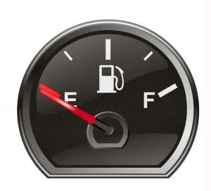
Introduction to the dataset
The data contains fuel efficiency performance metrics, measured in miles per gallon (MPG) over time.
Provided by U.S. Department of Energy and the US Environmental Protection Agency
Dataset link: http://www.fueleconomy.gov/feg/epadata/vehicles.csv.zip
Metadata link: http://www.fueleconomy.gov/feg/ws/index.shtml#vehicle
The dataset consist of 43921 records and 83 columns
This vehicle data is recorded since 1985, for 39 years.
Dependent variable: Ucity
Independent variable: Make, co2, barrels,model, displ,fuetype1 etc.

Slide 3
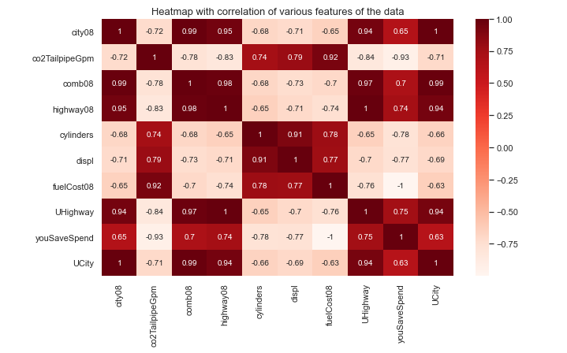
Exploratory Data analysis 1.Correlation Analysis
Ucity have high or strong positive correlation with these selected features such as - city08, comb08, highway08, Uhighway and yousavespend.
Ucity have moderate to strong correlation with theese features but in negative -co2tailppegpm, cylinders,displ, fuelcost08. It means these variables are inversely proportional to Ucity.
Here, ucity = city08, we need to dropit.

Slide 4
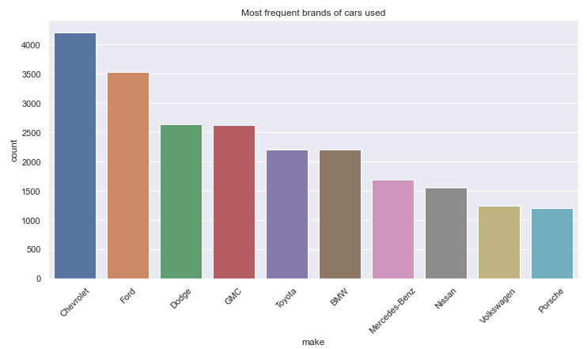
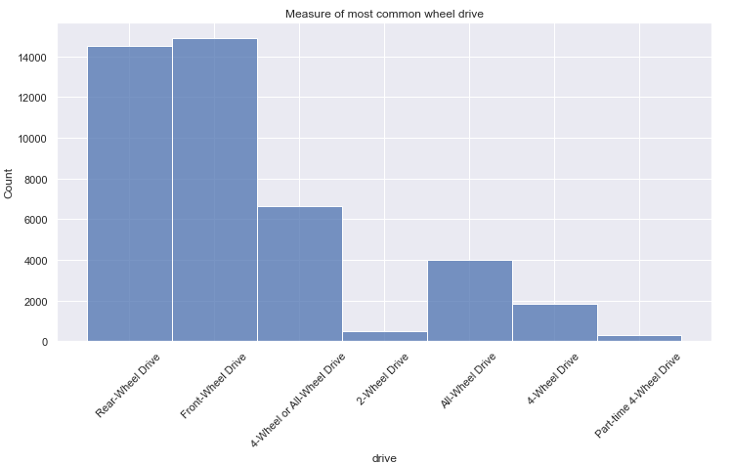
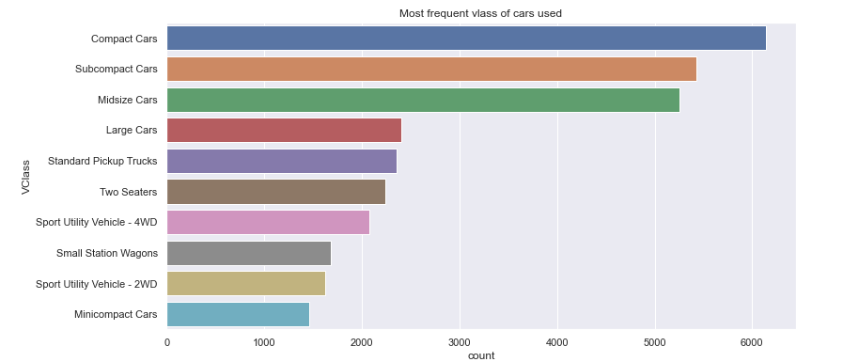
Univariate Analysis
Most common wheeldrive used
Most frequent brands of car used
Rear/front wheel drive
4 wheel or all-wheel drive
Chevrolet, ford, dodge, GMC are top 4
Most common class type of cars used
Compact
Subcompact
mid-size cars

Slide 5
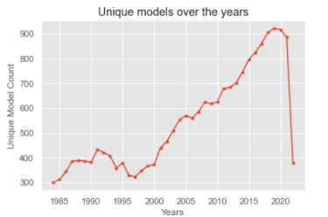
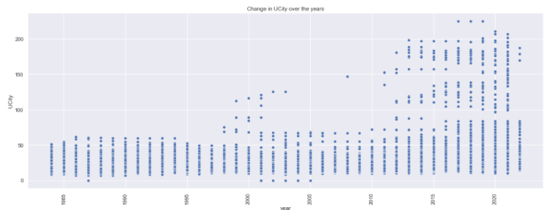
Bivariate Analysis
Unique model counts increased over the years
Change in Ucity over the years.
UCity average over the years shows that after 2010 there has been a significant improvement in quality of vehicles.
This shows that there has been a substantial growth in count of unique models over the years after 1996.

Slide 6
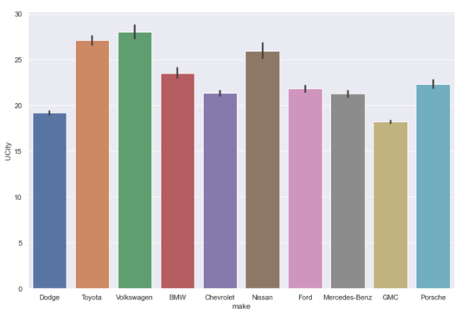
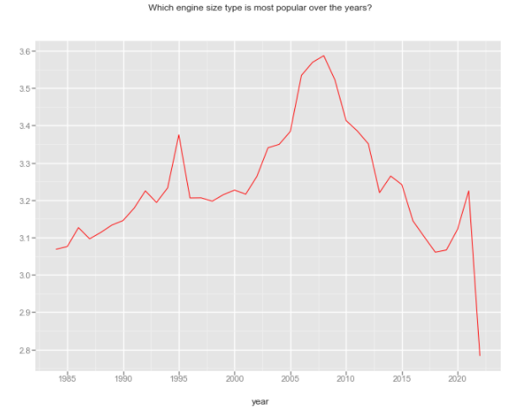
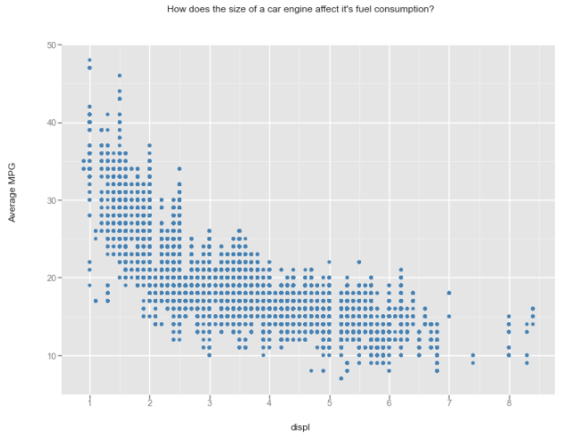
Cont..
Which cars have the highest Ucity average?
Volkswagen, Toyota, and Nissan have the highest UCity average.
How does the size of a car engine affect its fuel consumption?
Small engine size cars are more fuel efficient
Which engine size type was most popular over the years?
More small cars with small engine types were used after 2008.

Slide 7
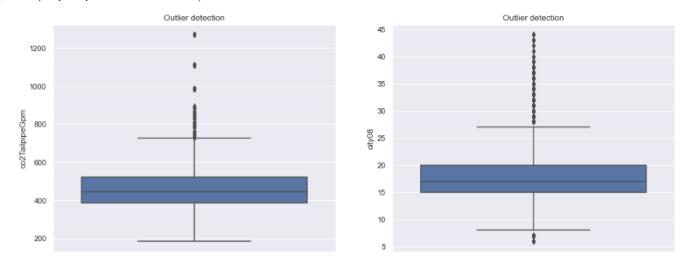
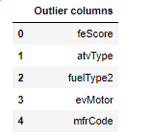
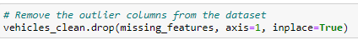
Data Cleaning
Outliers:
Some columns have few outliers, but these outliers cannot be removed as it can affect training dataset performance.
A few outliers lie in co2tailpipeGpm and will be treated with scaling
Save/spend ratio have outliers but can be explained with expensive and luxuries vehicles
Outliers with missing value with threshold of 25%
Remove this outliers from dataset.

Slide 8
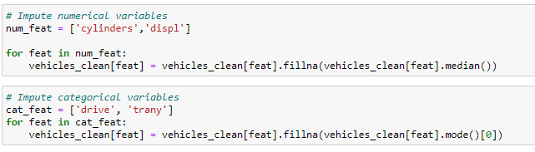
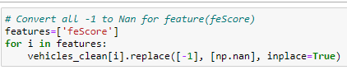
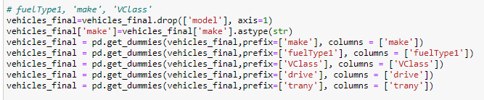
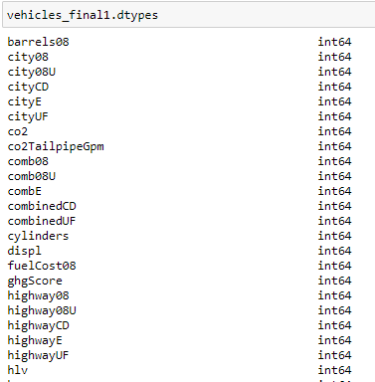
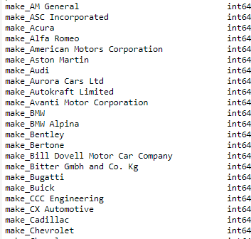
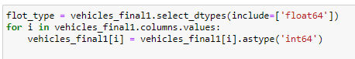
Data Cleaning
Transforming numerical/Categorical missing data by Imputation
Replaced character missing data with “Not Available”
Replaced values missing but entered -1 with nan
IntegerEncoded and HotEncoded the character data
Performed scaling on continuous variables to treat the outliers
Also converted float object into int .

Slide 9
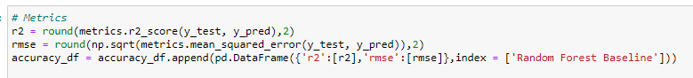
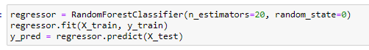
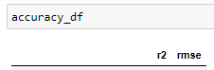
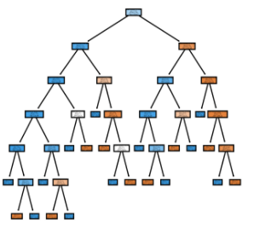
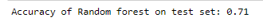
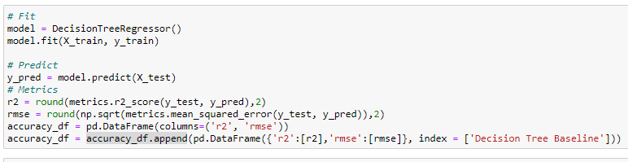
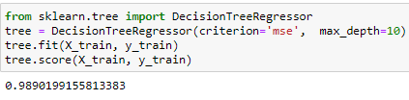
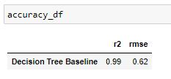
Model Building
In model building, the task is to train machine learning models to fit and predict the target variable.
Developed two models
1. Random Forest model
→ Random forest model achieved a loss of 0.71, with RMSE 0.79
2. Decision Tree model
→The decision tree model achieved a loss of 0.989, this shows a good result

Slide 10
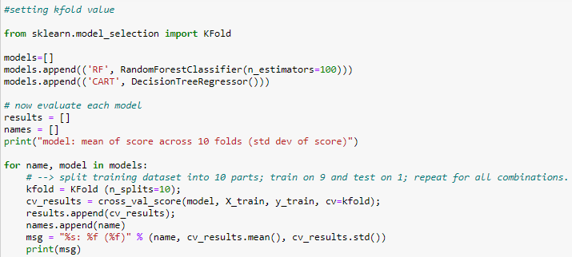
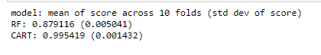
K-Fold Cross Validation
Cross-validation is a resampling procedure used to evaluate machine learning models on a limited data sample.
Used 10-fold Cross-Validation to train these models. Models to evaluate are
Random Forest Model (RF )and Decision tree Model (CART)
It optimized the random forest training set and achieved 0.88
→Decision tree model shows more accuracy in K Fold cross validation as compared to Random Forest model for k=10 splits in this analysis and model creation.

Slide 11
Conclusion
Decision tree model is the best algorithm for this dataset through the process of K fold cross validation as compared to random forest model.
UCity average over the years shows that after 2010 there has been a significant improvement in quality of vehicles.
Volkswagen, Toyota, and Nissan have the highest UCity average.
There is a negative correlation between engine displ and fuel efficiency that means small engine size cars are fuel efficient.
Displacement has started decreasing its popularity in 2008 from 3.6 that means more small cars with small engine types were used.
There has been a substantial growth in count of unique models over the years after 1996.
Comb08- shows a positive relationship in which the higher the MPG value, the more you will save and spend less
Barrels08 shows a negative relationship in which the more the annual consumption, the more you will spend and save less.

Slide 12

Thank you

